Slide 1
Los Angeles Traffic Collision Prediction Using Pytorch GNNs
Edward Seymour

Slide 2
Data Sources:
- SWITRS dataset on traffic collisions in California. The set contains over 300,000 collisions in the city of Los Angeles from 2007 to 2021.
- LAPD data on non-highway traffic collisions from 2010 to present.
- LADOT data on traffic volume for a number of streets in LA county.
- OpenWeather API provides weather data used for training the model. This set has more useful weather factors, mainly visibility, than the SWITRS dataset.
-Google Maps Geolocation API to get the coordinates of intersections in the traffic volume dataset.

Slide 3
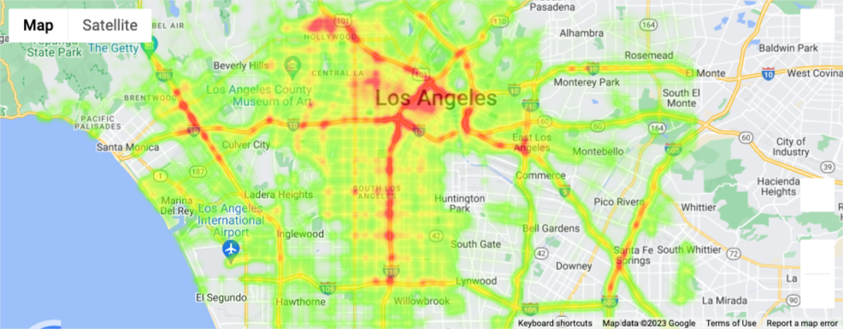
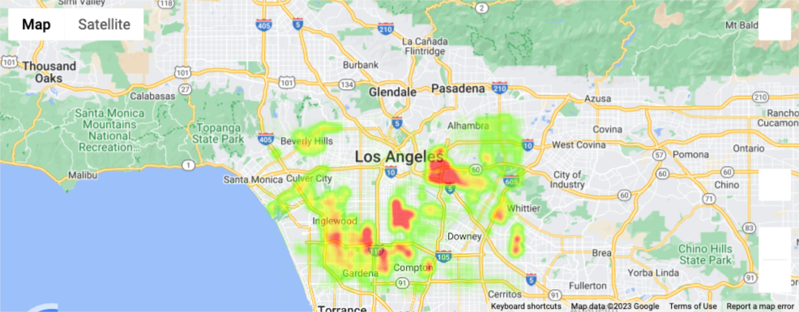
Heatmaps of Highway and NonHighway Collisions
Highway collisions account for most of the data.
Most collisions occur in the center of the city

Slide 4
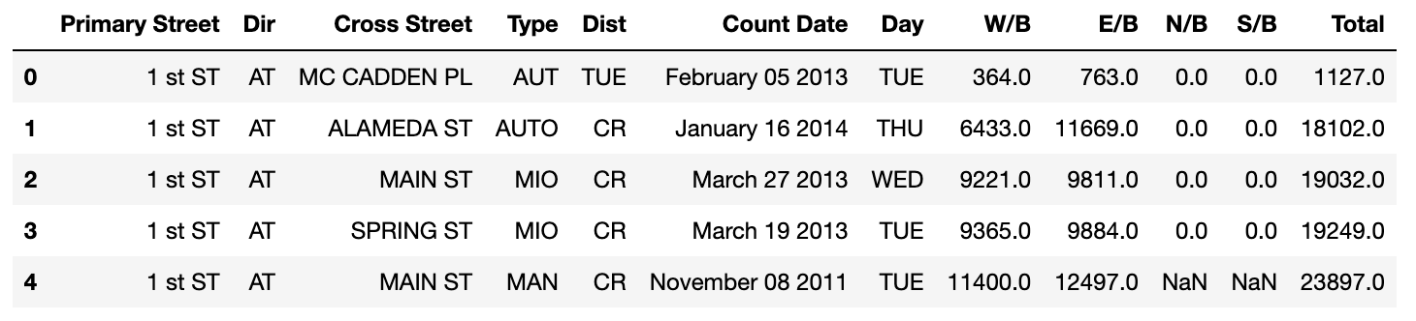
Traffic Volume Sample

Slide 5
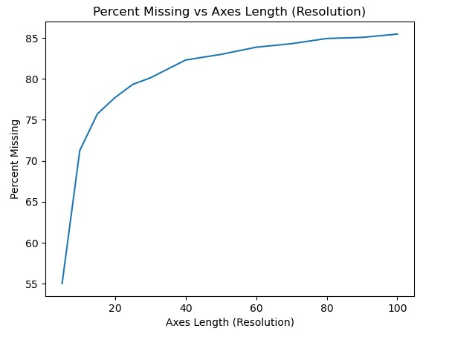
Spatial Resolution
The best spatial resolution for the graph data was a 50x30 or a 1 mile by 1 mile grid.
The best temporal resolution was determined to be a 1 hour period, as most of the data was already formatted this way.

Slide 6
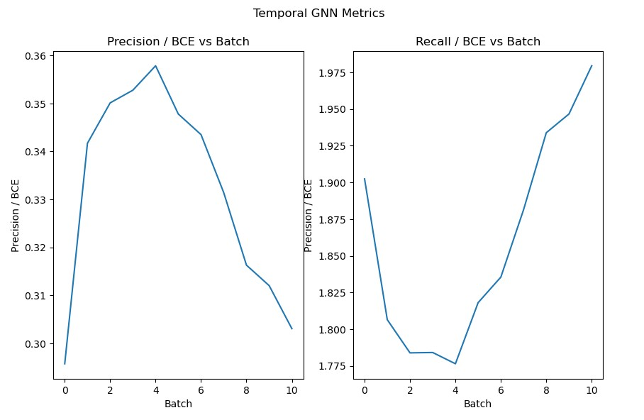
Temporal GNN
Poor results due to large amounts of false positives.
Model does much better at avoiding false negatives

Slide 7
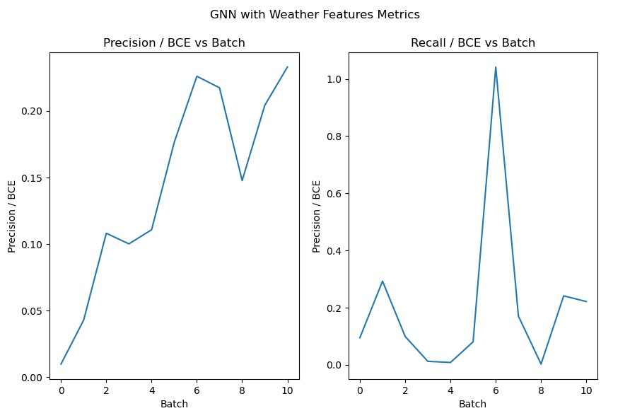
GNN with Weather Variables
This model appears to have progressively gotten better throughout training
Better on false positives, but much worse on false negatives

Slide 8
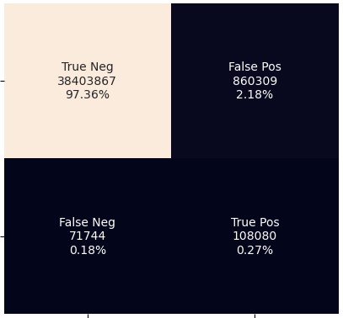
GNN with Weather Variables Confusion Matrix

Slide 9
Conclusions
The variables available in the datasets were simply not enough to describe the occurrence of collisions
A lot was learned during this project concerning GNNs, and neural networks in general

